Slide 1
CAMPUS EATS DATABASE GROUP-
Mrunal Tilekar
Nikhitha Reddy Modugu
Shalini Marneni
Tejaswi Maddineni
https://github.com/ModuguNikhitha/DBgroupproject.git

Slide 2
INTRODUCTION
Team Maverick created a food delivery app and we extended the project by adding a rating system to the that. The goal of the project is to perform a rating procedure to all the restaurants and delivery personnel depending on their performance.
We added the following tables:
Rating
Menu
Order
The rating table has the following columns, rating_id(PK), food_rating, delivery_rating, comments, picture_link, order_id(FK).
The menu table has the following columns, item_id (PK), item_name, item_desc, restaurant_id (FK).
The menu_order table is an associative table which has the following columns, menu_order_id(PK), item_id, order_id and cooking_specification

Slide 3
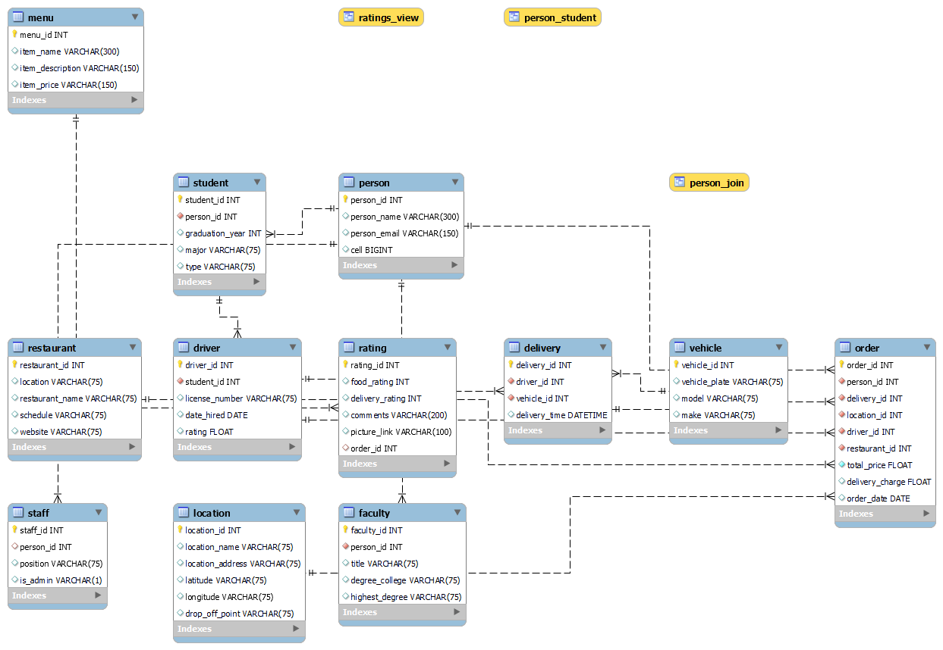
EERD

Slide 4
OPERATIONS
The 3 advanced sql statements include: functions, stored procedures, indexes and views. We have also added indexes to two columns.
Functions:
get_restaurant_id
get_person_id
get_item_id
Views:
delivery_driver_ratings
restaurant_rating_stats
restaurant_ordersVSreviews
Stored Procedures:
del_driver
Del_rating
Indexes:
del_id

Slide 5
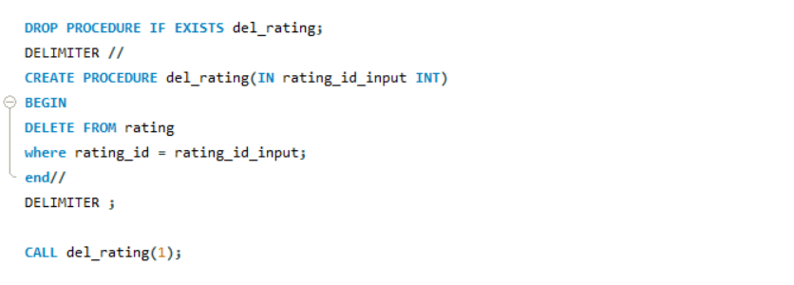
DEMO
Stored procedure 1:

Slide 6
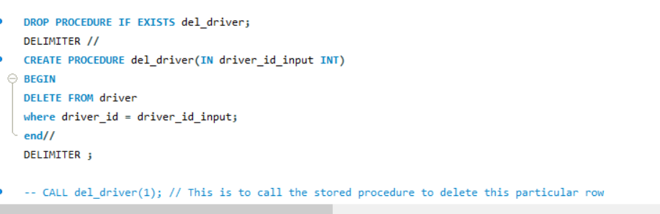
Stored procedure 2:

Slide 7
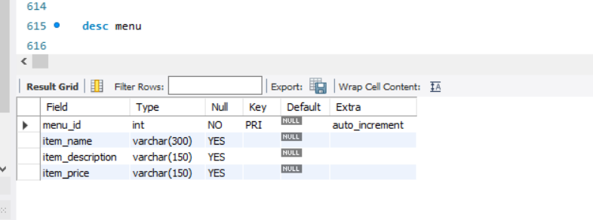
Menu table:

Slide 8
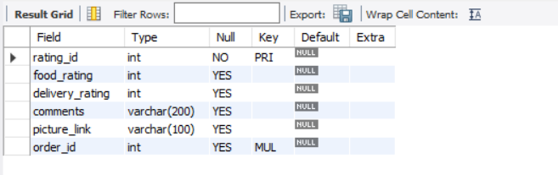
Ratings table:

Slide 9
THANK YOU

